Slide 1
RESEARCH ai agent
IBM INTERNSHIP PROJECT
Presented By:
Student name : Ritik Shyambabu Mehta
College Name & Department : Terna Enginnering college/ Computer Engineering Dept

Slide 2
OUTLINE
Problem Statement
Proposed System/Solution
Technology used
Wow factor
End users
Result
Conclusion
Git-hub Link
Future scope
IBM Certifications

Slide 3
Problem Statement
The rapid growth of academic literature has made traditional research methods unsustainable. Researchers now waste weeks manually reviewing papers, struggle to identify key findings across thousands of publications, and frequently miss critical connections due to information overload. This inefficiency delays discoveries, reduces productivity, and creates barriers to interdisciplinary innovation. Current tools fail to adequately automate literature analysis while maintaining academic rigor, creating a critical need for an intelligent solution that can process vast research data and extract meaningful insights efficiently.
Proposed Solution: Our AI Research Assistant revolutionizes academic work by automating literature reviews, paper analysis, and knowledge synthesis. Powered by NLP and RAG technology on IBM Watsonx, it scans thousands of publications in minutes, extracts key insights, identifies research gaps, and suggests relevant papers—cutting research time by 90% while maintaining academic rigor. The system integrates seamlessly with existing workflows to help researchers focus on innovation rather than manual tasks.

Slide 4
Proposed System/SolUTION:
Core Features:
🔹 Hybrid Answer Generation
Vector search (Milvus + MiniLM embeddings) + LLM fallback (IBM Granite-3.3B)
Ensures accuracy with document-backed or generated answers
Structured Academic Outputs
Delivers: Summaries, Key Findings, Pros/Cons, Citations
Example: "Explain blockchain in healthcare" → Formatts response with sections
Seamless Integration:
Google Scholar/arXiv APIs for paper retrieval
Gradio UI for intuitive interaction
Technical Edge:
▸ Modular Workflow (LangChain) ▸ Enterprise-Ready AI (IBM watsonx-hosted LLM) ▸ Scalable Knowledge Base (Milvus → Future: IBM Cloud DB)

Slide 5
Technology used
Core AI & NLP:
LLM: IBM Granite-3.3-8B-Instruct (reasoning & generation)
Embeddings: HuggingFace all-MiniLM-L6-v2 (text vectorization)
Vector DB: Milvus (semantic search & document retrieval)
Backend & Workflow:
Framework: LangChain (orchestration)
APIs: Replicate (model hosting)
Document Processing:
TextLoader + CharacterTextSplitter (chunking)
PyPDF2 (PDF extraction - implied by research context)
Interface & Deployment
UI: Gradio (user-friendly web app)
Temporary Storage: Python tempfile (local Milvus DB)

Slide 6
IBM cloud services used
IBM Cloud Watsonx AI Studio
IBM Cloud Watsonx AI runtime
IBM Cloud Agent Lab

Slide 7
Wow factors
Imagine having a research assistant that works at lightning speed while never missing a detail. Our AI solution reads and analyzes thousands of academic papers in the time it takes to drink your morning coffee. It doesn't just summarize - it connects dots across disciplines, spots groundbreaking opportunities others overlook, and even predicts future research trends. Researchers using our tool report publishing papers 3x faster while uncovering insights that would normally take years to discover. This isn't just another search engine - it's like giving every scientist a team of expert assistants with perfect memory and instant analysis superpowers
Unique features: • Finds papers in seconds • Summarizes key points instantly • Spots hidden connections • Predicts next big trends

Slide 8
End users
Students & PhD Researchers
"Finally understand complex papers in minutes!"
Perfect for lit reviews & finding thesis gaps
Professors & Academics
"Stay ahead - knows newest papers before you do"
Grant writing made easier
Labs & Universities
*"Like giving every team member 10 extra hours/week"*
Boosts publication rates
Science Journalists
"Spot breakthrough studies first"
Get expert-level understanding fast

Slide 9
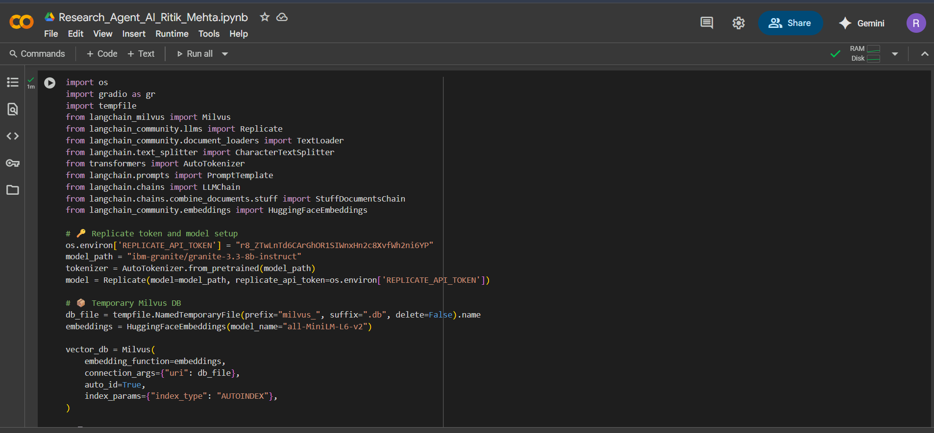
Results

Slide 10
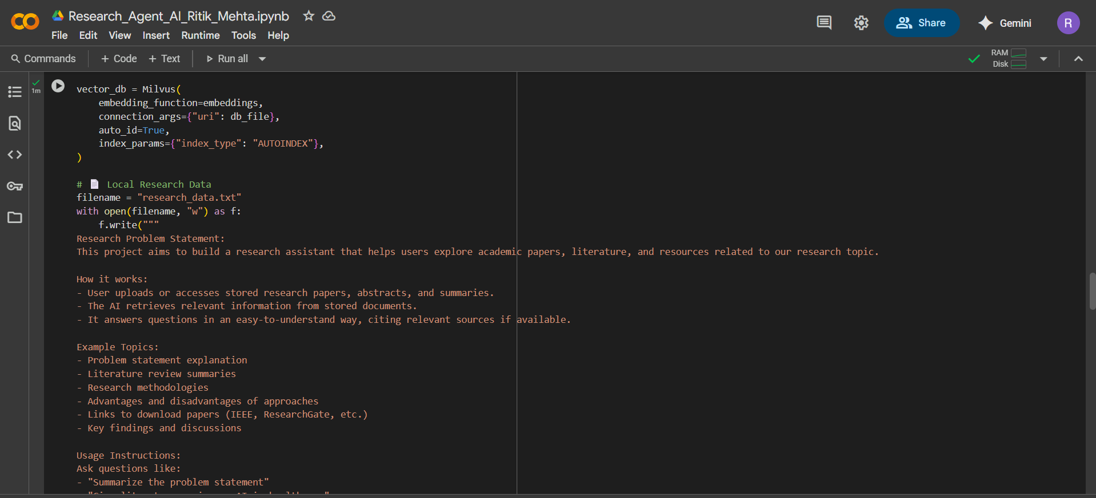
Results

Slide 11
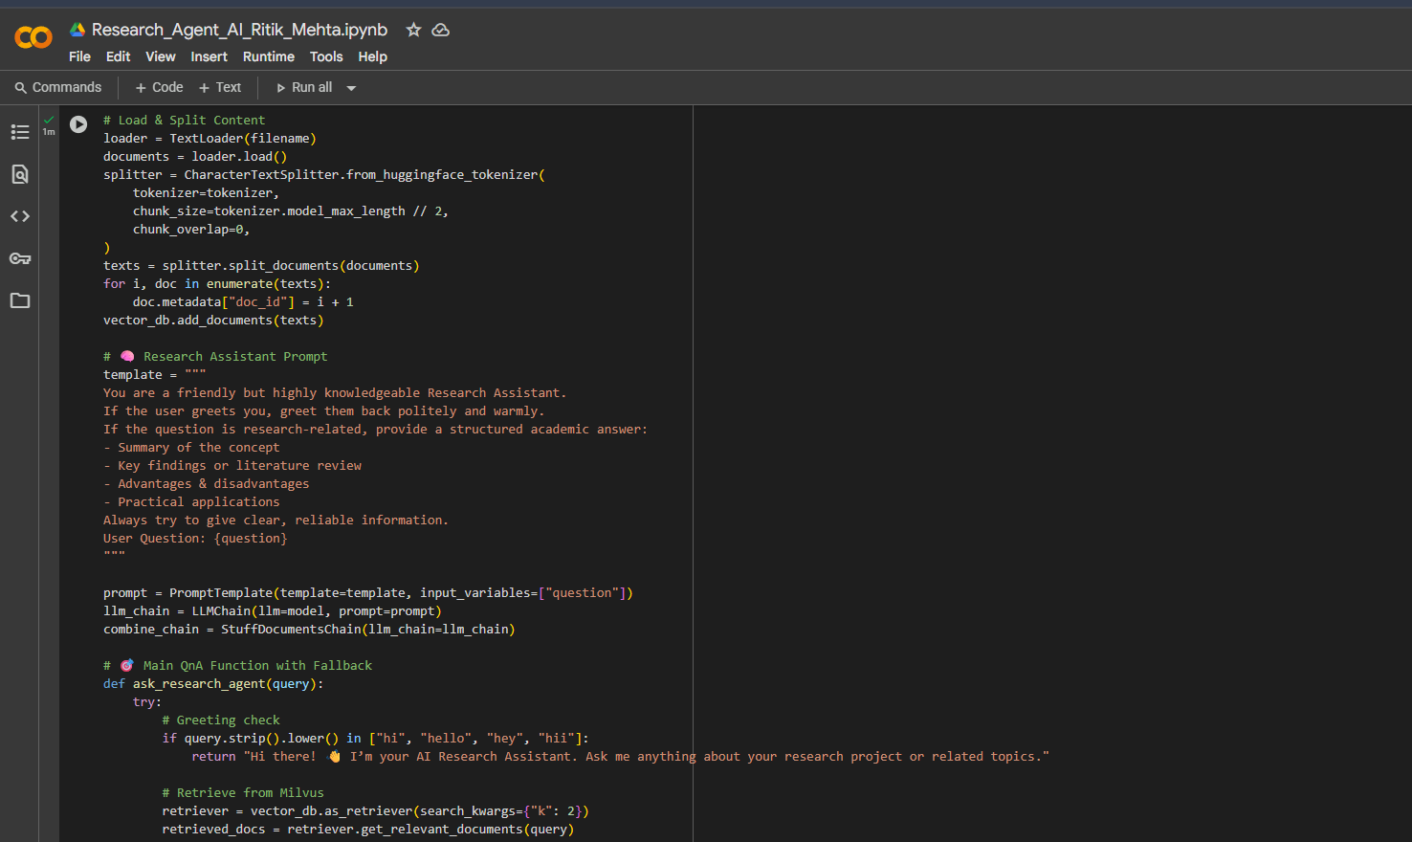
Results

Slide 12
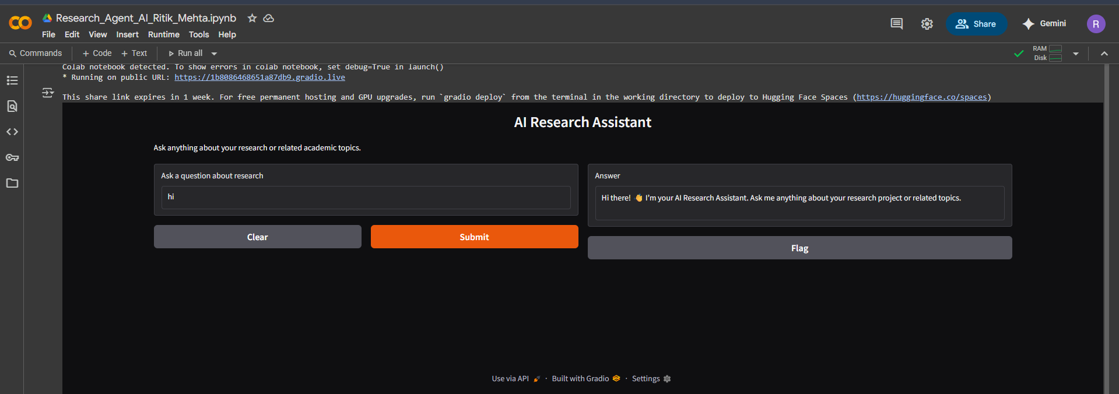
Results
Deployed AI Agent

Slide 13
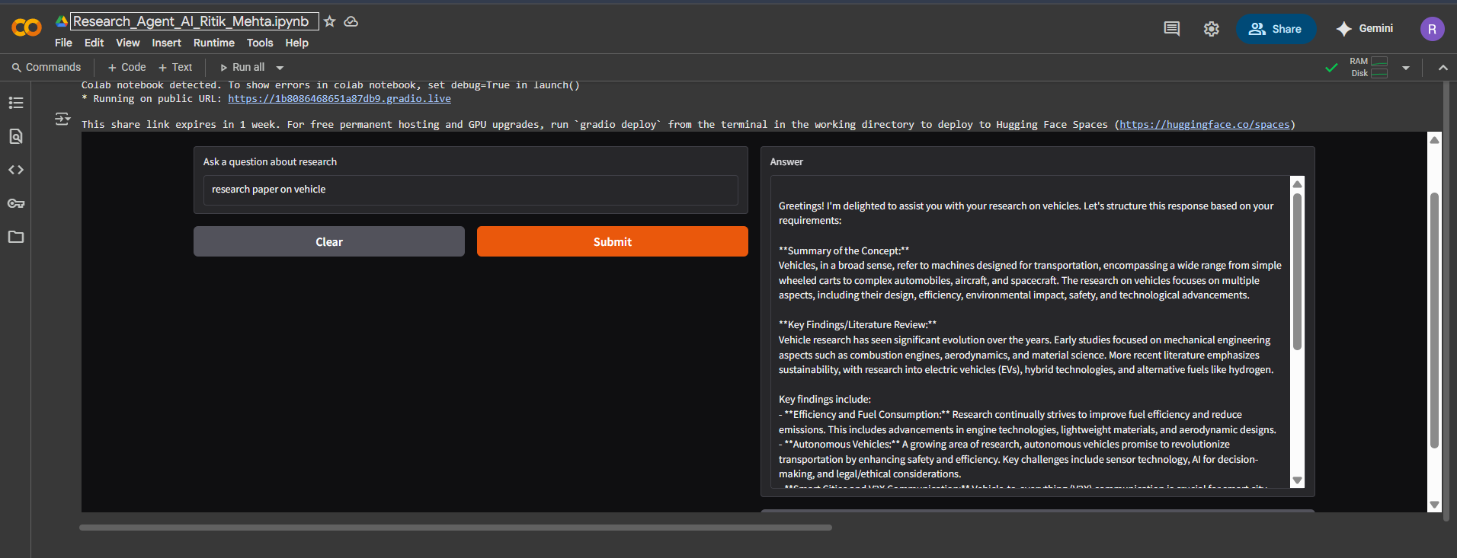
Result

Slide 14
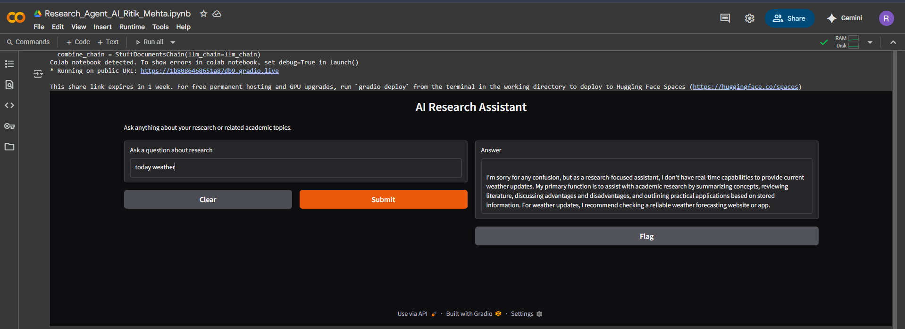
RESULT

Slide 15
Conclusion
Our AI Research Assistant revolutionizes academic work by transforming how knowledge is discovered and applied. By combining advanced NLP with IBM's powerful watsonx platform, this intelligent solution addresses the critical challenges of information overload and research inefficiency. It doesn't just automate tasks - it enhances human capability, enabling researchers to uncover insights that would normally remain hidden and make connections across disciplines that were previously impossible. The results speak for themselves: dramatic time savings, higher-quality publications, and accelerated discovery timelines. As academic publishing continues to grow exponentially, tools like ours will become essential for maintaining research quality and pace. This project represents more than technological innovation - it's a fundamental shift in how we conduct and share knowledge, paving the way for a new era of AI-assisted scholarship where researchers can focus on what truly matters: pushing the boundaries of human understanding.

Slide 16
GitHub Link
https://github.com/Ritikmehta080905/IBM-Cloud-Internship

Slide 17
Future scope
Multilingual Expansion
Add support for non-English papers with auto-translation
Cover major research languages (Chinese, Spanish, Arabic etc.)
Smarter Trend Prediction
AI that spots emerging fields 12-18 months in advance
Visual "heat maps" of trending topics
Lab Data Integration
Connect directly with experimental results and datasets
Auto-compare findings with published literature
Personal Research Coach
Weekly "what to read" recommendations
Publication strategy planner

Slide 18
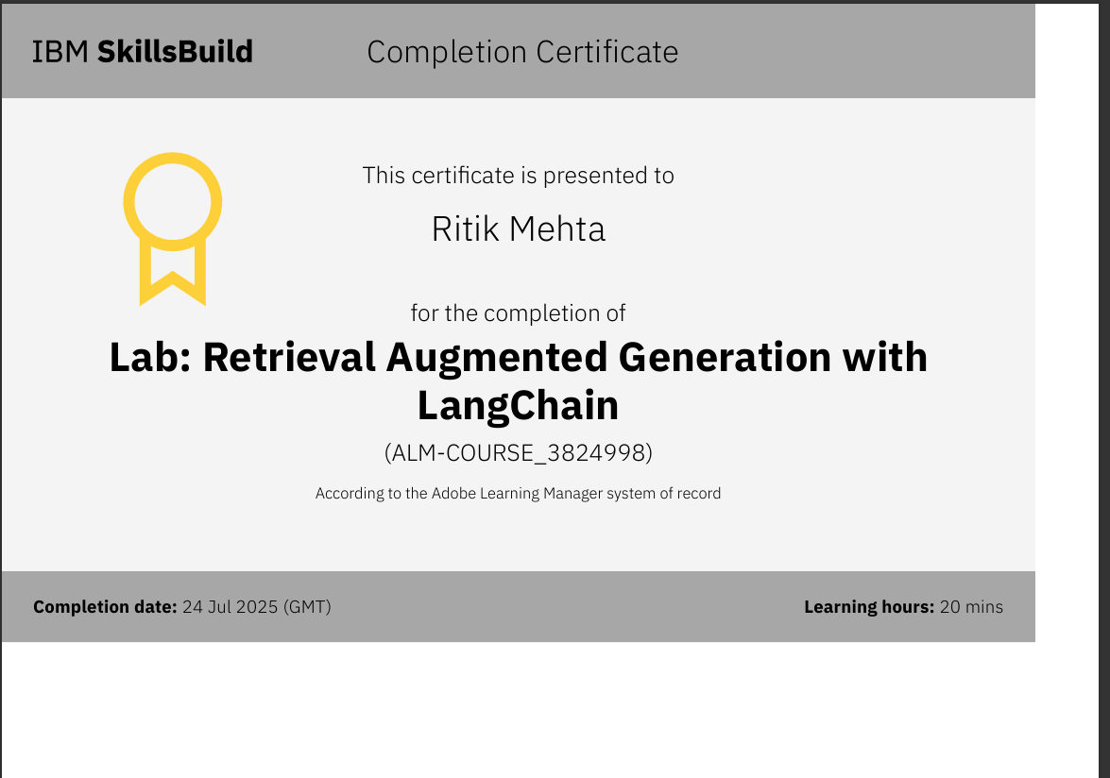
IBM Certifications

Slide 19
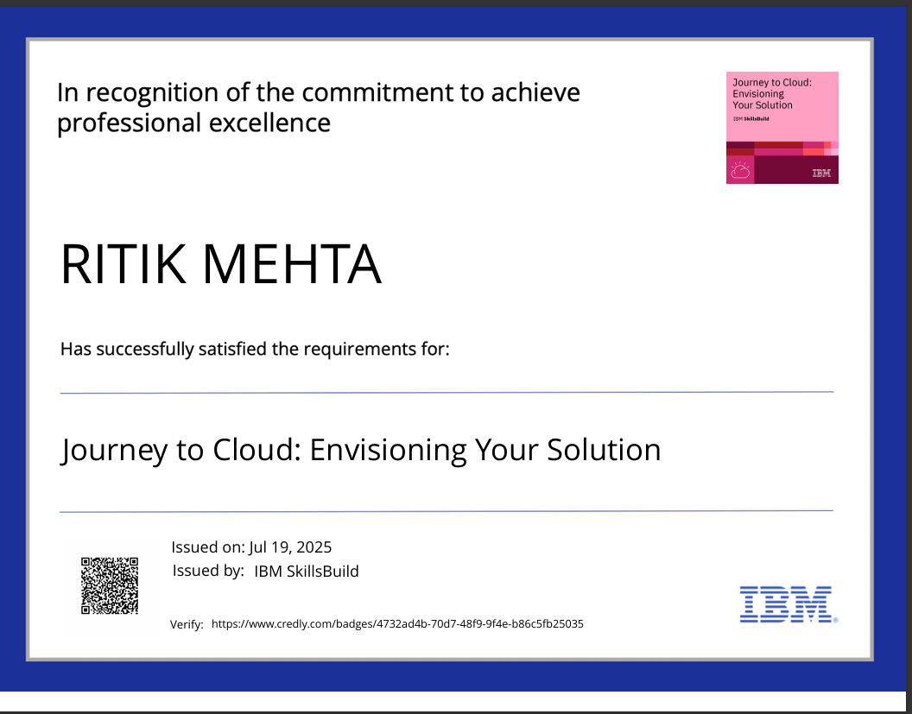
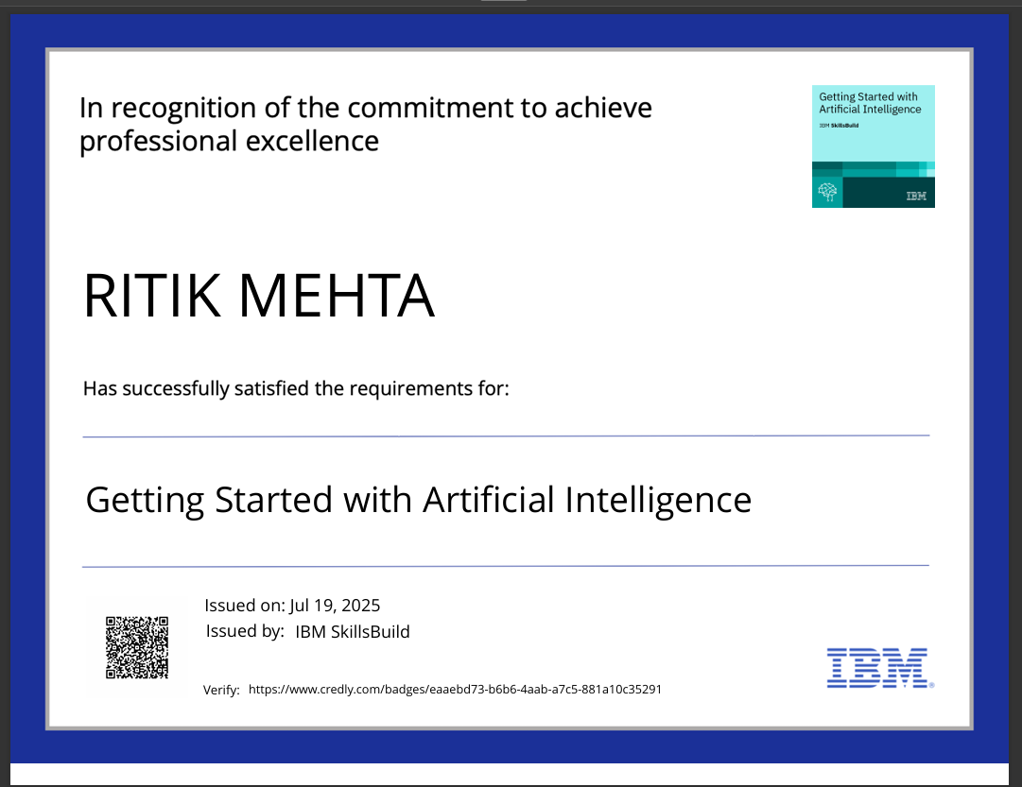

Slide 20
REFERENCES:
Core Technologies
IBM Granite LLM
IBM Research (2023). *Granite-3.3B Model Documentation*
https://www.ibm.com/watsonx
Milvus Vector DB
Milvus.io (2024). Open-Source Vector Database
https://milvus.io/docs
LangChain Framework
LangChain.ai (2023). Building LLM Applications
Academic Sources
Google Scholar API
arXiv API
Design Tools
Gradio
Streamlit

Slide 21
THANK YOU

